Slide 1
UC endpoint monitoring
Issue
Proactively detect and analyze disconnected calls, poor media quality and alert the respective stakeholders
Support for various video endpoints such as SX,DX,Spark Kits
Proactive monitoring
Solution
Custom built solution to cater proactive mechanism to monitor, detect and notify the user about poor media quality and drop calls
Improved TAT for media quality and call drop issue
Notes:
BULLETED NOTES:
Our expert engineers know Cisco equipment and networks. They use experience gained from a broad range Cisco devices and customer networks as well as customer specific solutions to provide value above and beyond what the customer can get with home grown or third party tools

Slide 2


UC Mon Architecture Diagram
Register for event
Video End Points
Register Service
Rabbit MQ
Service
Notify Events
Web Service
Publish Events
Start Polling
Subscribe Events
UCMON App Service
Logging
Analyzing
Logger
Alert Notification
Analyzer
Tivoli Server
Video Endpoints
File Beat /
Elastic Server

Slide 3
Solution Approach
Framework | Modular | Scalable
Utilizes Cisco Telepresence Endpoint APIs. | The solution has separate classes to monitor, collect stats, analyze and includes interfaces to third party apps to push alert notification. The solution can be easily expanded to integrate with other custom applications | The solution runs in either Poll mode or Event mode. In Poll mode, it sequentially polls each phone based on the phone list stored in its property files. In Event mode, the solution enables target polling by detecting phones with active calls. This approach improves scalability and performance of the application.

Slide 4
Application Overview
Registrar Module | Webserver | WebServer MQ Class | UCMONAPP MQ Class | Rabbbit MQ Service
At startup and every 30 mins to subscribe SX/DX phones. | Http Server to receive events from the phone. Converts it to structured format Publishes to Webserver MQ Class | Runs two threads (Control and data). Control thread to maintain heartbeat with MQ service. Data thread publishes events to rabbit MQ service. | Runs two threads (Control and data) Control thread to maintain heartbeat with MQ service Data thread receives events from rabbit MQ service | An open source application. It provides broker service to webserver and ucmonapp to pass messages to each other.

Slide 5
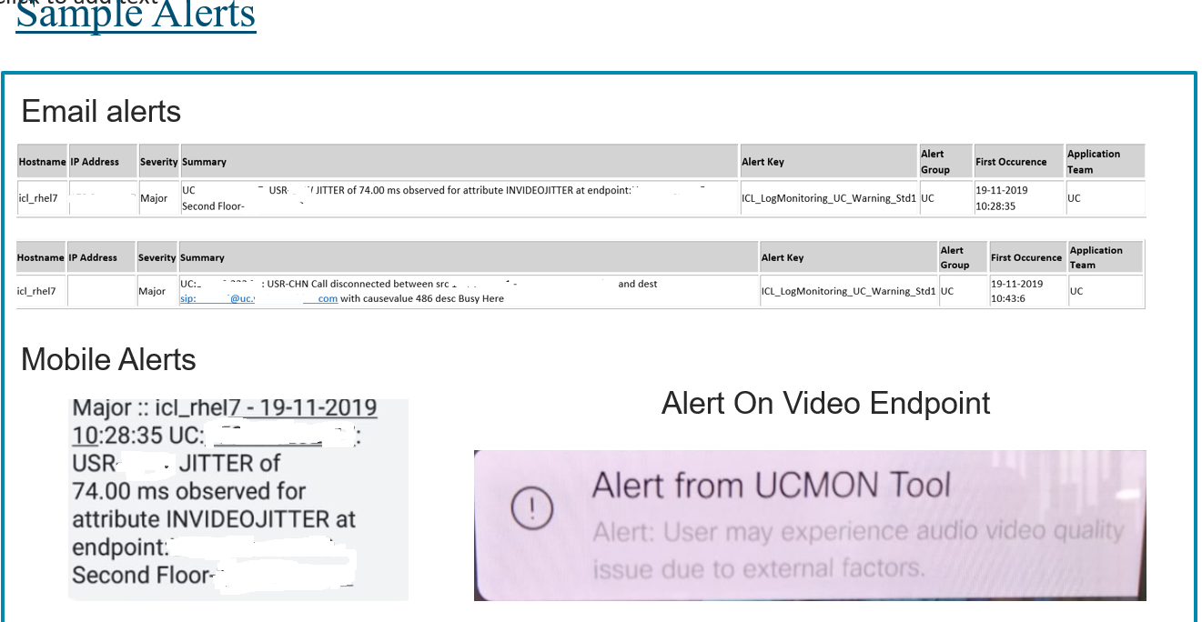

Slide 6
Register logs
2019-11-19 10:07:19,956 - INFO –
register - 51- post request body
<?xml version="1.0" ?>
<Command>
<HttpFeedback>
<Register command="True">
<FeedbackSlot>2</FeedbackSlot>
<ServerUrl>http://192.168.0.1:8080</ServerUrl>
<Expression item="2">/Event/CallSuccessful</Expression>
<Expression item="3">/Event/CallDisconnect</Expression>
</Register>
</HttpFeedback>
</Command>

Slide 7
UC MON Alert logs
Aug 02 21:26:08 rhel7.1 python[13450]: 2019-08-02 21:26:06.862777 : message 19 filtered msg dict {'CURINAUDIO': 88}
Aug 02 21:26:08 rhel7.1 python[13450]: 2019-08-02 21:26:06.862804 : message 19 filtered msg dict {'CURINVIDEO': 20}
[root@rhel7 UCMONAPP]# journalctl | grep “Manoj Raju"
Aug 02 20:29:51 rhel7.1 python[61979]: 2019-08-02 20:29:50.972595 : main 206 send to syslog for device Manoj Raju
Aug 02 20:29:51 rhel7.1 python[61979]: 2019-08-02 20:29:50.973780 : main 356 send to VC syslog for device Manoj Raju

Slide 8
Hardware and software specification
Programming language – Python 2.7 or above
Supported OS – Red hat Linux 7.x, 6.x /Centos 7.x,6.x/Windows 2008 R2 or 64 bit window operating system
CPU – 4 vCPU
RAM – 4 GB
Disk – 80 GB
Plugins – RabbitMQ service 3.7.17, Erlang 20.3.x or above

